Slide 1
Anthony Steed

Slide 2
Part 1:
Introduction
Networking Fundamentals
Anthony Steed

Slide 3
Goals
Understanding the application domain
Understanding the constraints the theoretical and practical constraints of distributed simulation over the Internet
Common strategies for mitigating constraints whilst satisfying
Practical tools for building networked virtual environments and networked games
Examples and literature that you can use to further your own knowledge

Slide 4
Session 1 (9:00 – 10:30)
Introduction
- What are networked graphics?
- Potted history of networked graphics
Networking Fundamentals
- Basic Internet technologies
- Basic networking strategies
- Why are all types of networked graphics “non-standard” networking applications?

Slide 5
Session 2 (11:00 –12:30)
Actual Internet Performance
- What bandwidth can we expect?
- Sources of latency
- What other issues must we consider?
Requirements and Constraints
- Requirements on consistency
- Requirements on latency
- User response to inconsistency and latency

Slide 6
Session 3 (13.30 – 15:00)
Latency
- Mitigation strategies
- Playout delays, local lag and dead reckoning
Scalability
- Management of awareness
- Interest specification
- Server partitioning

Slide 7
Session 4 (15:15 – 16:45)
Application Support
- Security, Protocol decisions
- Persistence
Tools
- Middleware
- Networked engines
Research Issues
- Scalable peer-to-peer, thin clients
- Standards, etc.

Slide 8
Materials
See handout
All materials available from speaker
Also on:
  http://www.networkedgraphics.org/materials/ieeevr-2011
Many more materials (code, blog posts, paper links, etc.) on:
  http://www.networkedgraphics.org/

Slide 9
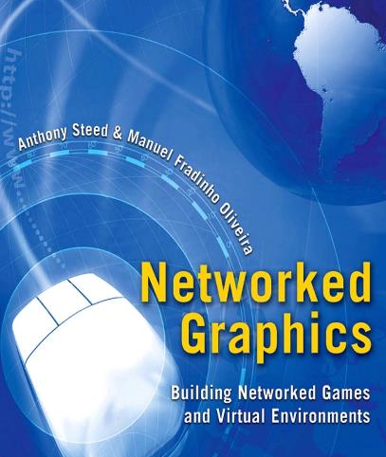
For Much More Detail
Anthony Steed & Manuel Oliveira
Published by Morgan Kaufmann (2009 US, 2010 EU&Other)
576 pages
Covers today’s topics in more depth plus more background

Slide 10
Introduction
Anthony Steed

Slide 11
Introduction
What are networked graphics?
Potted history of networked graphics

Slide 12
WHAT ARE NVES AND NGS?

Slide 13
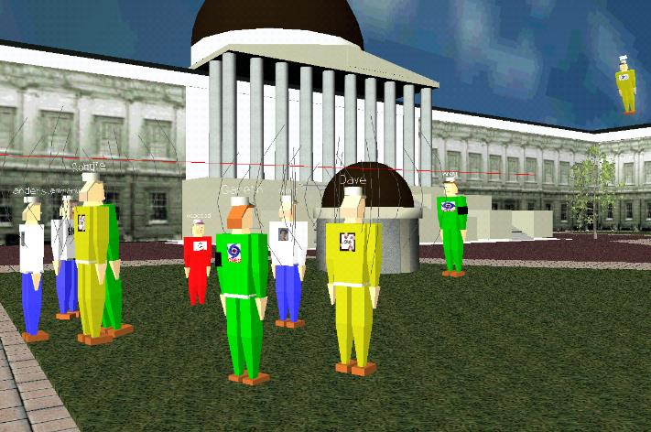
DIVE

Slide 14
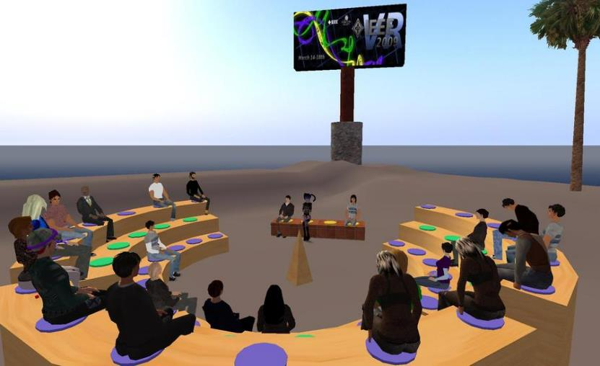
Second Life
Notes:
IEEE Virtual Reality 2009 programme committee meeting, autumn 2008

Slide 15
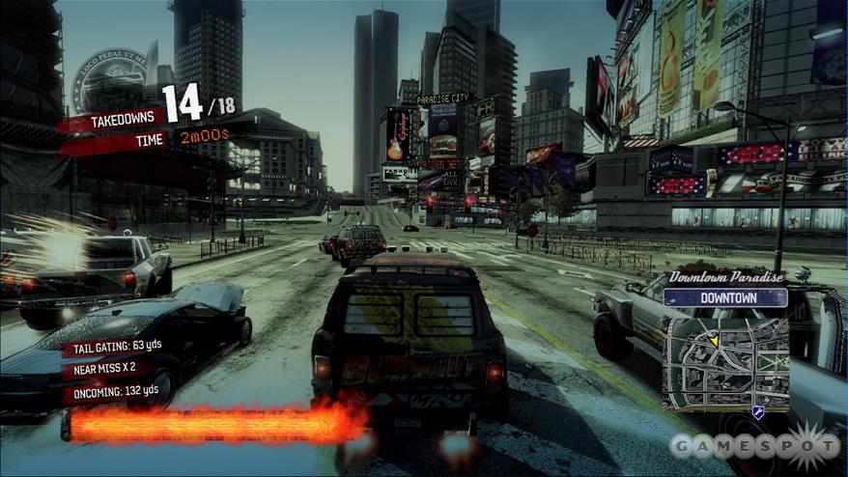
Burnout™ Paradise

Slide 16
Common Themes
3D virtual environment
Real-time changes
Collaboration with other users
  Representation of users in the world (typically as avatars, but also cars/tanks/etc.)
  Text communication
  Voice
Virtual environment might mirror a real place but typically is a fantastic place

Slide 17
Common Themes
One client is usually responsible for generating the view for one user
A set of clients creates the illusion of a shared virtual environment
“Illusion” because
  Virtual environments can involve detailed models
  Information about changes in models takes time to travel across communication links

Slide 18
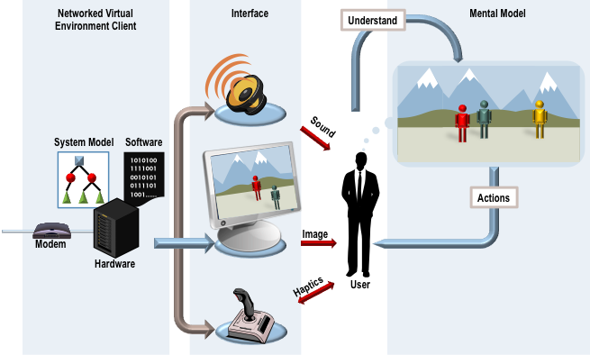
Virtual Environment Client
Notes:
Figure 1.27

Slide 19
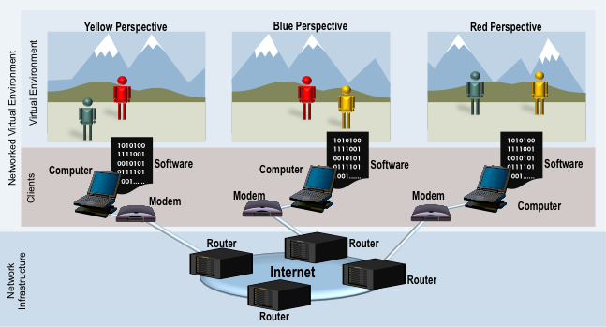
Networked Virtual Environment
Notes:
Figure 1.2

Slide 20
Consistency and Plausibility
Local plausibility is the appearance of consistency of only local actions
Shared plausibility is the appearance of properties being the same as observed by users
  Objects that are in the background need not be consistent
  Further: only things that might be the focus of joint attention can be discussed and be different
A local implausibility might be an obvious thing to talk about!

Slide 21
Why NVEs are not Standard Network Applications
Unlike video/audio streaming, or web browsing, in an NVE or NG client, networking is NOT the main activity: rendering probably is
Some information changes very quickly and smoothly
  E.G. player positions
Can incorporate other web-enabled media
  Audio/video
Often require bulk download of assets

Slide 22
SOME HISTORY

Slide 23
Simulation
Real-Time Strategy
Networked Games
Electronic Games
MORPGs
Social Environments
MUD
Network
E-mail
WWW
Notes:
Figure 1.3

Slide 24
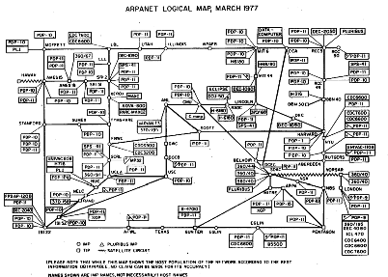
ARPANET
Diagram of ARPANET circa 1977

Slide 25
SIMNET
SIMNET aircraft simulation. Left: A view of the simulator control. Right: a view from the cockpit of an aircraft simulator. Images from ( Harris, 1994)

Slide 26
MUD1
A screenshot of the text interface of the MUD1 system over a standard telnet client

Slide 27
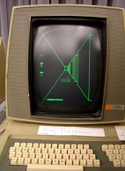
Maze (Maze War)
Maze War running at on Imlac PSD-1D at DigiBarn's Maze War 30 Year Retrospective (Digibarn, 2004)

Slide 28
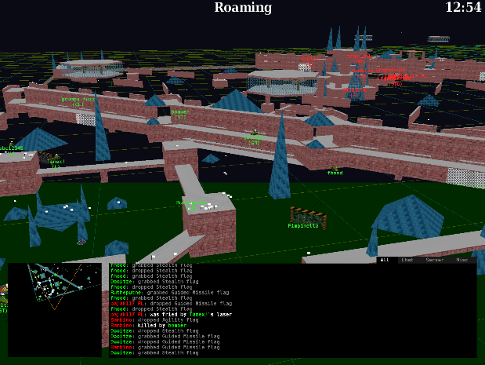
BZFlag
A screenshot of the current BZFlag

Slide 29
DOOM
DOOM™ (iD Software) was the first multi-player first-person shooter to reach wide-spread public attention

Slide 30
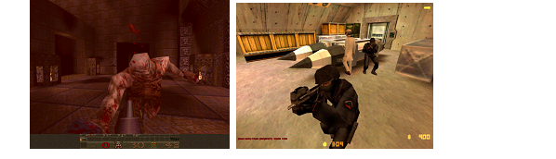
Quake
Quake (id Software) brought true 3D and was the basis for several licensed games. Left: the original Quake game. Right: Counter-Strike (Valve Software), originally a modification of the game Half-Life which was based on Quake engine.

Slide 31
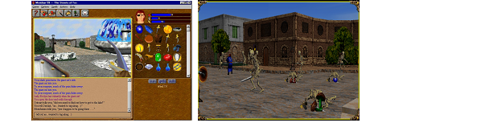
Meridian 59
Meridian 59. Left: a view of the client. Right: an army of skeletons invades the Streets of Tos. This screenshot is from a more recent version of the client software.

Slide 32
Ultima Online
Pirates demanding tribute
(Schultz, A., 2009)

Slide 33
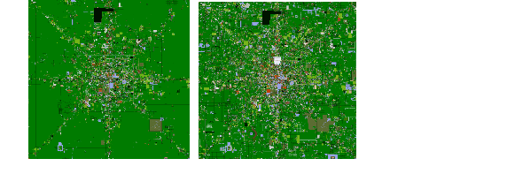
Active Worlds
Left: Map of Alphaworld in December 1996. Right: Map of Alphaworld in August 2001.

Slide 34
Networking Fundamentals
Anthony Steed

Slide 35
Networking Fundamentals
Basic Internet technologies
Basic networking strategies
Why are all types of networked graphics “non-standard” networking applications?

Slide 36
Basic Internet Technologies

Slide 37
Introduction
Networks at the heart of networked VR
Many network protocols are out there
  TCP, UDP, multicast, RTP, etc
  Choice based on needs
Properties of the Internet

Slide 38
IP Stack
Application
DHCP, DIS, DNS, FTP, HTTP, IMAP, RTP, SMTP, SSH, Telnet
Transport
TCP, UDP, RSVP
Network
IP, ICMP, IGMP
Link
Ethernet, 802.11, ADSL
Physical
copper wires, fibre-optic cable, radio waves

Slide 39
From Messages to Frames
Application
Application Data
Message
Transport
Transport
Header
Segment
Network
Network
Header
Packet
Link
Link
Header
Link Footer
Frame
Physical
Notes:
Figure 3.2

Slide 40
Application Layer

Slide 41
Application Layer Protocols
Determine what messages are sent between applications
  Messages defined by syntax and semantics
Various standards for messages, typically set by RFCs (Requests for Comments) hosted by the IETF (Internet Engineering Task Force)

Slide 42
E.G. HTTP Request
If you connect to Host www.cs.ucl.ac.uk at Port 80
And then issue (type!) in ASCII the following message:
      GET /staff/A.Steed/ HTTP/1.1
      Host: www.cs.ucl.ac.uk
And issues (type) two carriage returns
You get …

Slide 43
…
HTTP/1.0 200 Document follows
MIME-Version: 1.0
Server: CERN/3.0
Date: Sun, 08 Feb 2009 15:25:18 GMT
Content-Type: text/html
Content-Length: 16150
Last-Modified: Wed, 21 Jan 2009 17:42:00 GMT
<?xml version="1.0" encoding="iso-8859-1"?>
<!DOCTYPE html PUBLIC "-//W3C//DTD XHTML 1.0 Transitional//EN" "http://www.w3.org/TR/xhtml1/DTD/xhtml1-transitional.dtd">
<html xmlns="http://www.w3.org/1999/xhtml" lang="en" dir="ltr">
<head>
<meta http-equiv="Content-Type" content="text/html; charset=iso-8859-1" />
<meta name="keywords" content="A. Steed, Anthony Steed, Department of Computer Science, University College London, virtual environments, virtual reality, computer graphics" />

Slide 44
Application Protocol Descriptions
Often ASCII preamble with binary assets inserted at known or marked positions
Some messages are designed to be carried over a reliable stream and are of unknown length (likely to be over TCP)
Some messages are small and it is not important if they get lost (likely to be over UDP)

Slide 45
Common Application Protocols

Slide 46
Domain Name Service (DNS)
Maps fully qualified domain names (narok.cs.ucl.ac.uk) to their IP addresses (128.16.5.123)
Is a network service, thus takes time
Time is variable because it’s a hierarchical search
Local DNS caches query responses for a time (e.g. 24 hours)
Otherwise needs to query a canonical domain

Slide 47
TRANSPORT LAYER

Slide 48
Transport Layer Protocols
User Datagram Protocol (UDP)
  Send a message (datagram) and forget about it
  No guaranteed delivery
  No guaranteed ordering
Transmission Control Protocol (TCP)
  Guaranteed, in-order stream of data from one host to another

Slide 49
End to End Principle
  Only the sender and receiver understand TCP or UDP (or other same or higher-level protocols). The other routers in the Internet do not.

Slide 50
UDP
All hosts on the Internet have an IP address
How does the network know which program wants it?
You additionally need (for UDP and TCP) a port number
  These are 16 bits numbers, so must lie in the range 0-65535
  Some are reserved, see later
Processes listen for incoming UDP packets
Need to check the packet for consistency

Slide 51
UDP Segment Layout
Bits | 0 15 | 16 31
0-31 | Source Port | Destination Port
32-63 | Length | Checksum
64+ | Data
Notes:
Figure 3.4

Slide 52
Application
Application
Application
Source Port = Port1
Destination Port = Port2
Destination Port = Port3
Transport
Transport
Network
Network
Link
Link
Notes:
Figure 3.5

Slide 53
TCP
In comparison to UDP, TCP offers:
  A connection-oriented services with bi-directional (full-duplex) communication
  Reliable transmission of messages in each direction
  Congestion avoidance, using variable rate transmission
  In order, and non-duplicate delivery of information
Applications add messages to an outgoing buffer
The buffer is streamed in packets to the receiver
The receiver reconstructs the buffer and extract packets

Slide 54
Application
Msg i
Transport
…
Msg i-2
Msg i-1
Buffer
Header
Data
Segment
Network
Link
Notes:
Figure 3.9

Slide 55
Layout of a TCP Segment
Bits | 0 15 |  |  | 16 31
0-31 | Source Port |  |  | Destination Port
32-63 | Sequence Number
64-95 | Acknowledgement Number
96-127 | Data Offset | Not Used | Flags | Receive Window
128-159 | Checksum |  |  | Urgent Pointer
160-191 | Options (Optional)
160+ 192+, 224+, etc. | Data
Notes:
Figure 3.10

Slide 56
TCP is Bi-Directional
Even if, logically, data only flows one way, in order to ensure reliability, we need return data which tells us which data has been successfully received (ACK)
The sender must maintain the buffered data until it receives an ACK

Slide 57
Transport
Byte Expected
Received Data
Receive Buffer
Sent Data
Unsent Data
Send Buffer
Start Byte
Start Byte + MSS
Header
Data
Sequence Number = Start Byte
Acknowledgement Number = Byte Expected
Notes:
Figure 3.11

Slide 58
Header
Data
Transport
Transport
Last Acknowledged
= M
Next Sequence Number
= N
Sequence Number = M
Expected
= N
Acknow-ledged
To Send
Unsent
Received
Just Received
Send Buffer
Receive Buffer
Header
Transport
Last Acknowledged
= N
Acknowledgement Number = N
Acknowledged
Unsent
Send Buffer
Notes:
Figure 3.12

Slide 59
TCP Reliability
How to detect if something has gone missing
  A timeout
  Returning an ACK repeatedly which indicates the buffer hasn’t grown

Slide 60
Packet Resent on Duplicate ACK
Seq # = 100
Data
Seq # = 200
Data
Ack # = 200
Data
Seq # = 300
Data
Ack # = 200
Data
Seq # = 200
Data
Host A
Ack # = 400
Data
Host B
Notes:
Figure 3.15

Slide 61
Packet Resent on Timeout
Seq # = 100
Data
Seq # = 200
Data
Ack # = 200
Data
Timeout
Seq # = 200
Data
Host A
Host B
Notes:
Figure 3.16

Slide 62
A Lost ACK Doesn’t Matter
Seq # = 100
Data
Seq # = 200
Data
Ack # = 200
Data
Seq # = 300
Data
Ack # = 300
Data
Ack # = 400
Data
Host A
Host B
Notes:
Figure 3.17

Slide 63
TCP Fairness
How does TCP decide when to send packets (with UDP you call “send”)?
It sends packets within increasing frequency but when they start going missing, it halves its rate
There are LOTS of variants of TCP
Protocols are often tested to see if there are TCP-fair, i.e. if N streams share a network link they get 1/N of the bandwidth
UDP protocols are often NOT TCP-fair, you need to add that functionality yourself

Slide 64
Rate (bytes/s)
30K
20K
10K
Time
Notes:
Figure 3.22

Slide 65
Observations
If there is lots of data to send TCP can fill up IP packets, UDP might waste network capacity
There are potentially lots of ACK packets in TCP
TCP is slow to start, UDP is rapid start
UDP protocols need to play fair when there is congestion

Slide 66
NETWORK LAYER

Slide 67
Network Layer
The Internet is a collection of machines that understand IP packets
A network routes packets from one host to another through routers
IP Packet
Router
IP Packet
Route
Table

Slide 68
IPv4
In IPv4 addresses are 32 bits in the form 128.16.13.118
They are running out and IPv6 is ready to be deployed

Slide 69
IP Packets
Key problem is what happens if links support frames of different size
  E.G. Ethernet is 1500bytes
The solution is that IP supports packet fragmentation, where a large packet is broken in to smaller ones: the end point must then reassemble them
Obviously try to pick a maximum transmission unit (MTU) that avoids this

Slide 70
IP Packet Format
Bits | 0 15 |  |  | 16 31
0-31 | Version | Header Length | Type of Service | Total Length
32-63 | Identification |  |  | Flags | Fragment Offset
64-95 | Time to Live |  | Protocol | Header Checksum
96-127 | Source Address
128-159 | Destination Address
160-191 | Options (Optional)
160+ 192+, 224+, etc. | Data
Bits | 0 15 |  |  |  |  | 16 31
0-31 | Version |  | Header Length |  | Type of Service | Total Length
32-63 | Identification |  |  |  |  | Flags | Fragment Offset
64-95 | Time to Live |  |  |  | Protocol | Header Checksum
96-127 | Data Offset | Not Used |  | Flags |  | Receive Window
128-159 | Source Address
 | Destination Address
160-191 | Options (Optional)
Notes:
Figure 3.24

Slide 71
Protocol Types
This is necessary to tell the receiver what the IP packet contains. E.G.s
  1: Internet Control Message Protocol (ICMP)
  2: Internet Group Management Protocol (IGMP)
  6: Transmission Control Protocol (TCP)
  17: User Datagram Protocol (UDP)
  89: Open Shortest Path First (OSPF)

Slide 72
LINK AND PHYSICAL LAYER

Slide 73
Link and Physical Layer
The one we all have experience with is Ethernet, either wired or wireless
Our experience is that for a specific Ethernet interface, we either need to:
  Set IP address manually
  Get an address automatically using DHCP
DHCP is actually an application-layer protocol
In both cases, we are making a mapping between the MAC address of the Ethernet adapter and the IP address

Slide 74
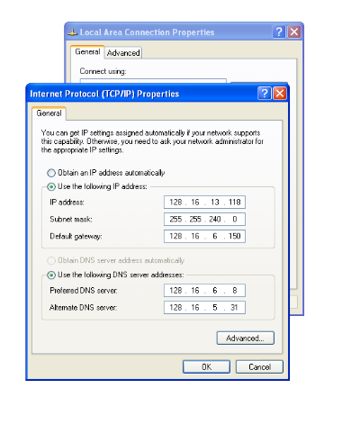
Notes:
Figure 3.31

Slide 75
Bits | 0 15 | 16 31
0-31 | Destination MAC Address …
32-63 | … Destination MAC Address | Source MAC Address …
64-95 | …Source MAC Address
96-127 | EtherType | Data
… | Data
… | CRC Checksum
Bits | 0 15 |  |  |  |  | 16 31
0-31 | Version |  | Header Length |  | Type of Service | Total Length
32-63 | Identification |  |  |  |  | Flags | Fragment Offset
64-95 | Time to Live |  |  |  | Protocol | Header Checksum
96-127 | Data Offset | Not Used |  | Flags |  | Receive Window
Notes:
Figure 3.33

Slide 76
Basic Networking Strategies

Slide 77
Architectures
Peer to Peer
Client/Server
Hybrid

Slide 78
Consider Just Two Machines
What is the relationship between them?
Peers?
Master/slave? Client/server?
Does one have data the other one does not?

Slide 79
Peer to Peer with Two Clients
Need to decide separation of responsibilities
  E.G. Each client simulates one player’s actions
Need to communicate sufficient information to the other that they can get both get the same state
Assumes that they have the same information other than real-time input
Can be achieved simply with sending input to each other

Slide 80
For Example DOOM
Doom Client_{A}
Doom Client_{C}
Read
Input
Read
Input
Receive
Input
Receive
Input
Simulate
Simulate
Rendering
Rendering
Notes:
Figure 11.6

Slide 81
Master Slave with Two Clients
One process calculates results of input
Necessary if simulation is non-deterministic

Slide 82
For Example
Slave
Master
Read
Input
Read
Input
Receive
Input
Simulate
Rendering
Rendering
Notes:
Figure 11.6

Slide 83
More Clients
The same issues exist:
  Who is responsible?
  Who has the necessary data to evolve the state?
  Who can be trusted to evolve the state?

Slide 84
Peer to Peer Architecture
Client
Client
Client
Client
Client

Slide 85
Client-Server Architecture
Server
Client
Client
Client
Client

Slide 86
Implications
Peer to Peer
  Data need to be sent multiple times on the network links might vary in bandwidth & latency
  Clients need to manage multiple connections
Client Server
  The Server is a bottleneck
  Clients manage one connection
  Server can have privileged data, and can probably be trusted
  Latency is higher
  Synchronization is easy

Slide 87
Hybrid Architectures
Server pool
Multiple servers serving different regions
Multiple service types & service layers

Slide 88
Which Protocol to Use?
If there is an application layer protocol that is appropriate use that!
UDP
  Good for fast changing data, and initial start update
  Good for position information
TCP
  Good for reliable data, and bulk data transfer
  Good for data assets and critical information such as score

Slide 89
Which Protocol to Use?
Some people implement “reliability-lite” on top of UDP
Other platforms mix UDP & TCP
  There are many catches with this
Many platforms support application layer protocols such as HTTP or FTP for bulk asset transfer

Slide 90
Summary

Slide 91
NVEs & NGs have a long history, but it is in the last 10 years that they have really taken off
The Internet is a best effort network where applications need to deal with latency & loss
There are various architectures that support NVEs & NGs
In Part 2 we will look in detail at NVEs and NGs requirements, and compare this to what we actually get from the Internet today

